Slide 1
Compass Plugins
lucas@mongodb.com
PhillyMUG - May 24th, 2018

Slide 2
⚡️

Slide 3
bit.ly/awesome-compass

Slide 4
🤔

Slide 5
Goals for Tonight
1. What are plugins?
2. Where did plugins come from?
3. Why do plugins matter?

Slide 6
0. What's Compass?

Slide 7


Slide 8
1. What are Compass Plugins?

Slide 9
Compass Plugin Framework
· React components for UI
· Glue for plugins to communicate with each other
· Reusable across Electron or Web

Slide 10
Compass Plugins are NOT
· Related to MongoDB Server
· Require rewriting your React components
· "The community will do it for us!"

Slide 11
2. Where did plugins come from?

Slide 12
Origins of Plugins
Distributed Team

Slide 13
Origins of Plugins
Iteration ⬆

Slide 14
Origins of Plugins
Cross-Product Reuse

Slide 15
Example
Server Stats Plugin

Slide 16
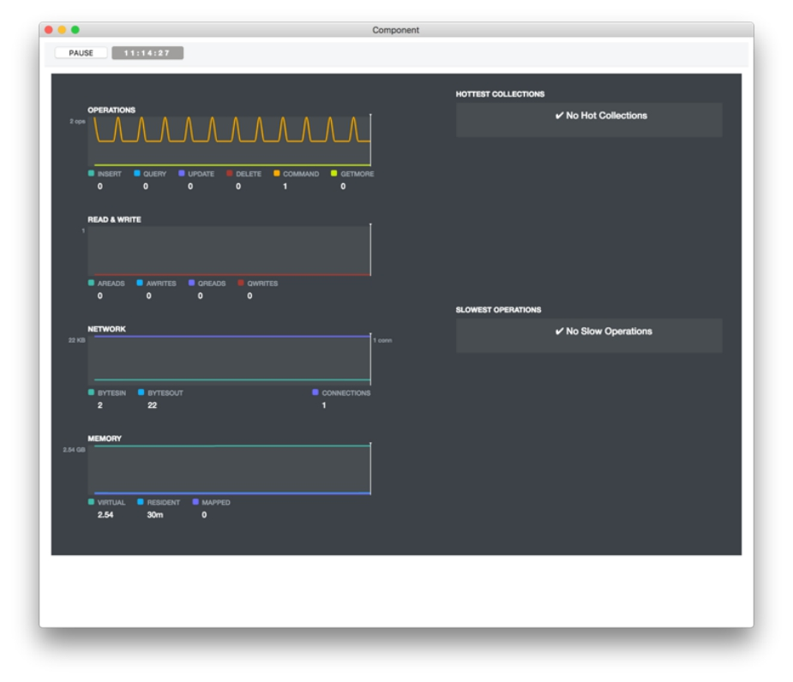
Plugin

Slide 17
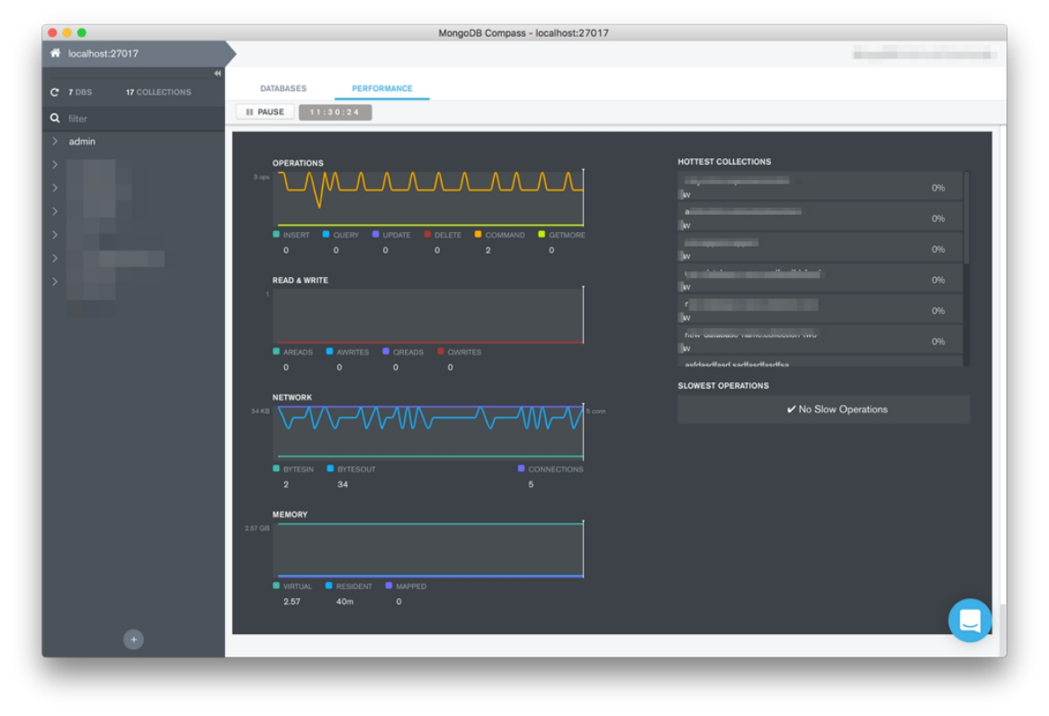
In Compass

Slide 18
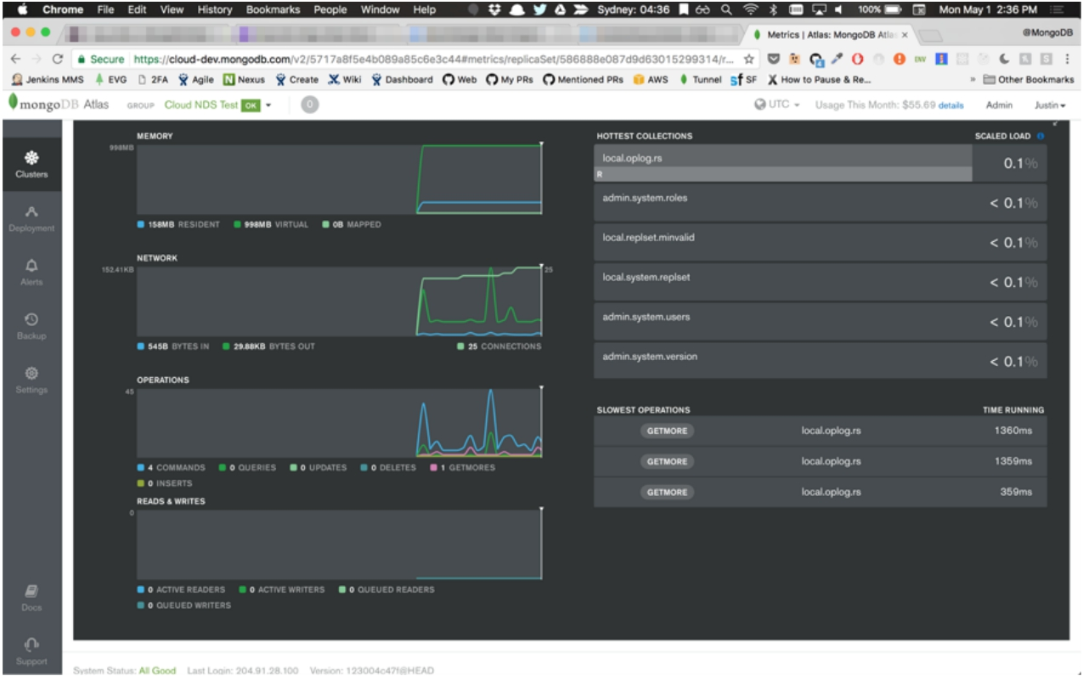
In Atlas

Slide 19
3. Why do plugins matter?

Slide 20
Why should everyone have to use the
same tools for different problems?

Slide 21
Example
BinaryData('asdias...')

Slide 22
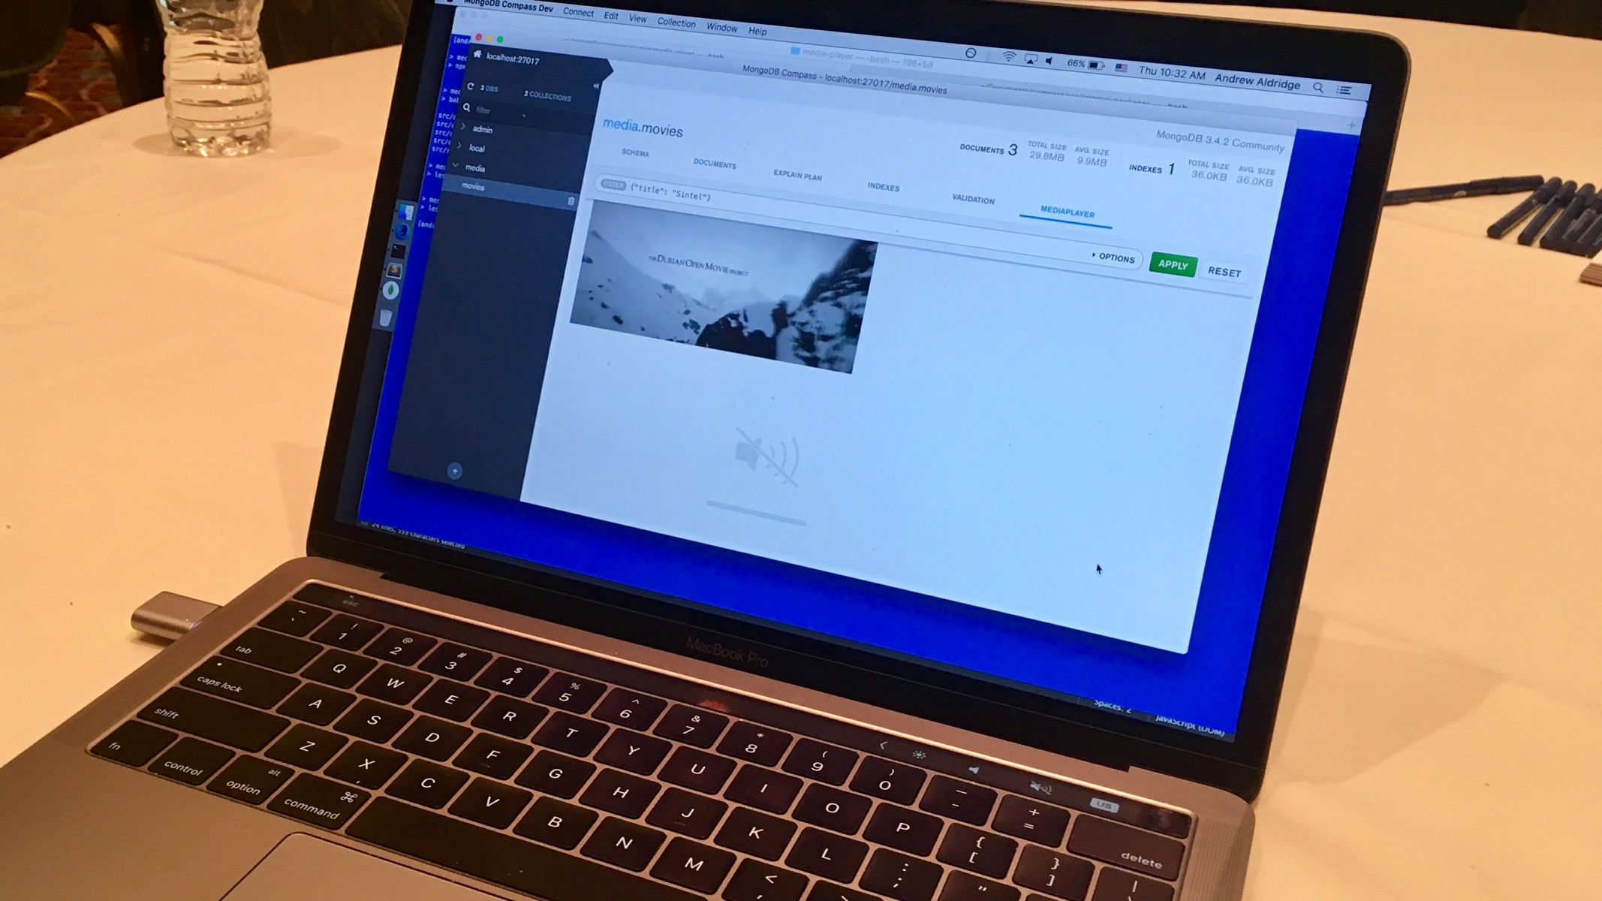

Slide 23
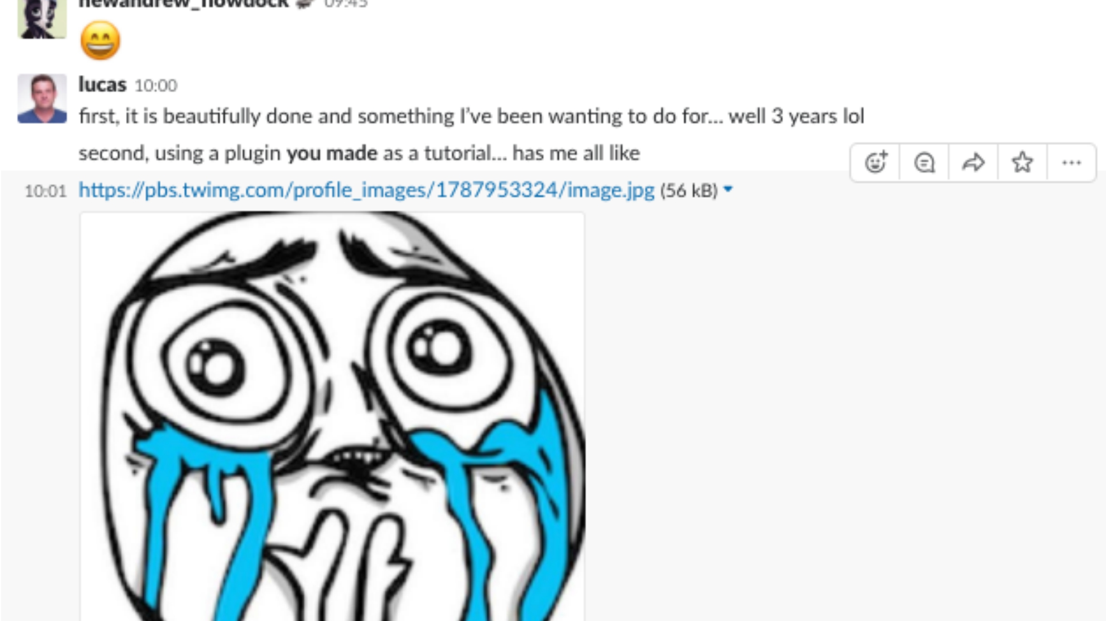

Slide 24
So…

Slide 25
What's next?

Slide 26
excel tables

Slide 27
data grids

Slide 28
JSON editor

Slide 29
?

Slide 30
Diversity is required.

Slide 31
Let's build together.

Slide 32
thanks
bit.ly/awesome-compass
lucas@mongodb.com

